Slide 1
Merging Things Together: Galaxy Merger Rate and IllustrisTNG
Theodore Peña
July 30, 2020
Space Astronomy Summer Program (SASP) Symposium

Slide 2
Introduction and Scientific Context

Slide 3
Why mergers?
Mergers play a large role in galaxy formation/evolution
Galaxy merger rate is traditionally an observational question
Simulations now advanced enough to provide new perspective

Slide 4
Simulation tools
Illustris: The Next Generation (TNG)
Hydrodynamical, high-volume, extremely accessible
www.tng-project.org/media/

Slide 5

Extracting merger rates from simulations
We can use pair fractions to determine merger rate:
$$Merger rate=\frac{Pair Fraction}{Observability time}$$

Slide 6
Our Methods and Work

Slide 7
Methodology
Goal: make directly comparable pair fraction predictions
Assemble lightcone catalogs
Perform data analysis on the catalogs
Notes:
Agnostic to simulation, so the same workflow is applicable to any illustrisTNG simulations.

Slide 8
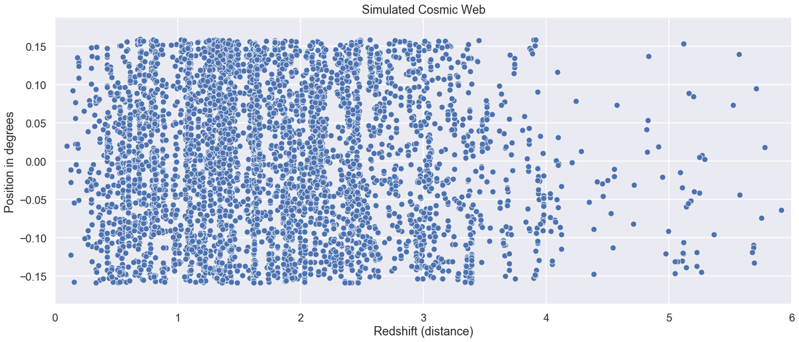
Lightcone catalogs

Slide 9
Finding pairs
Pair selection criteria:
Not too far apart
Not too close together
Of similar mass
At similar redshifts
Notes:
Merging galaxies must be…

Slide 10
Results and Conclusions

Slide 11
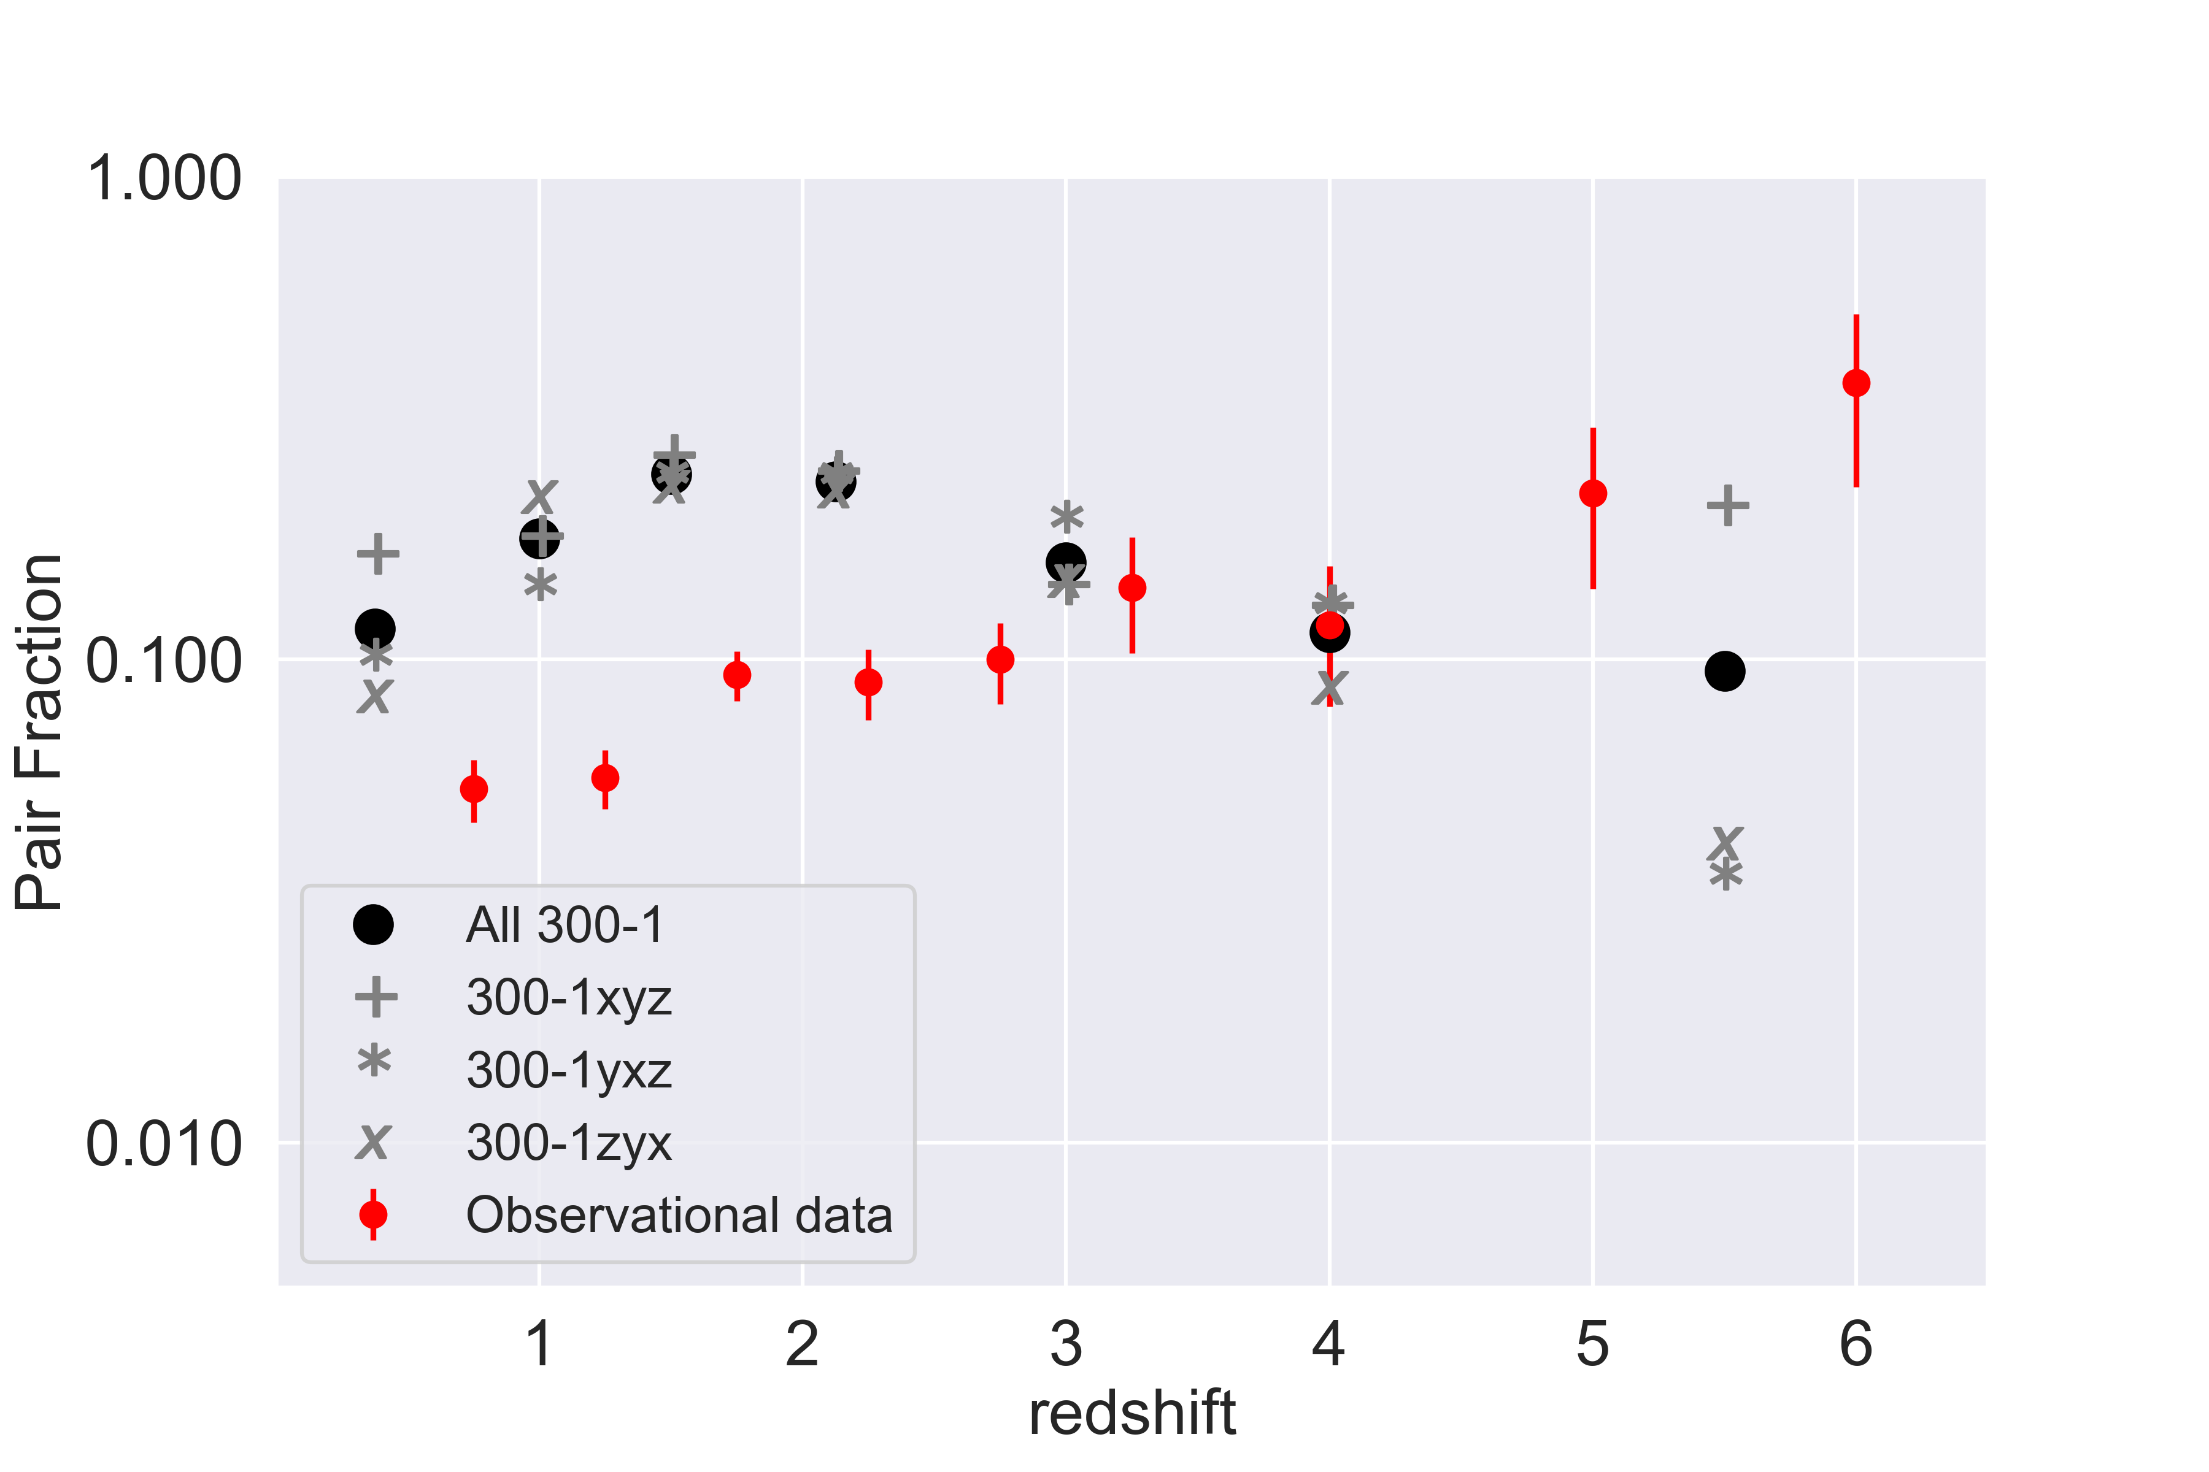
Comparing our results to observations
*
* Observational data from Duncan et al. (2019)

Slide 12
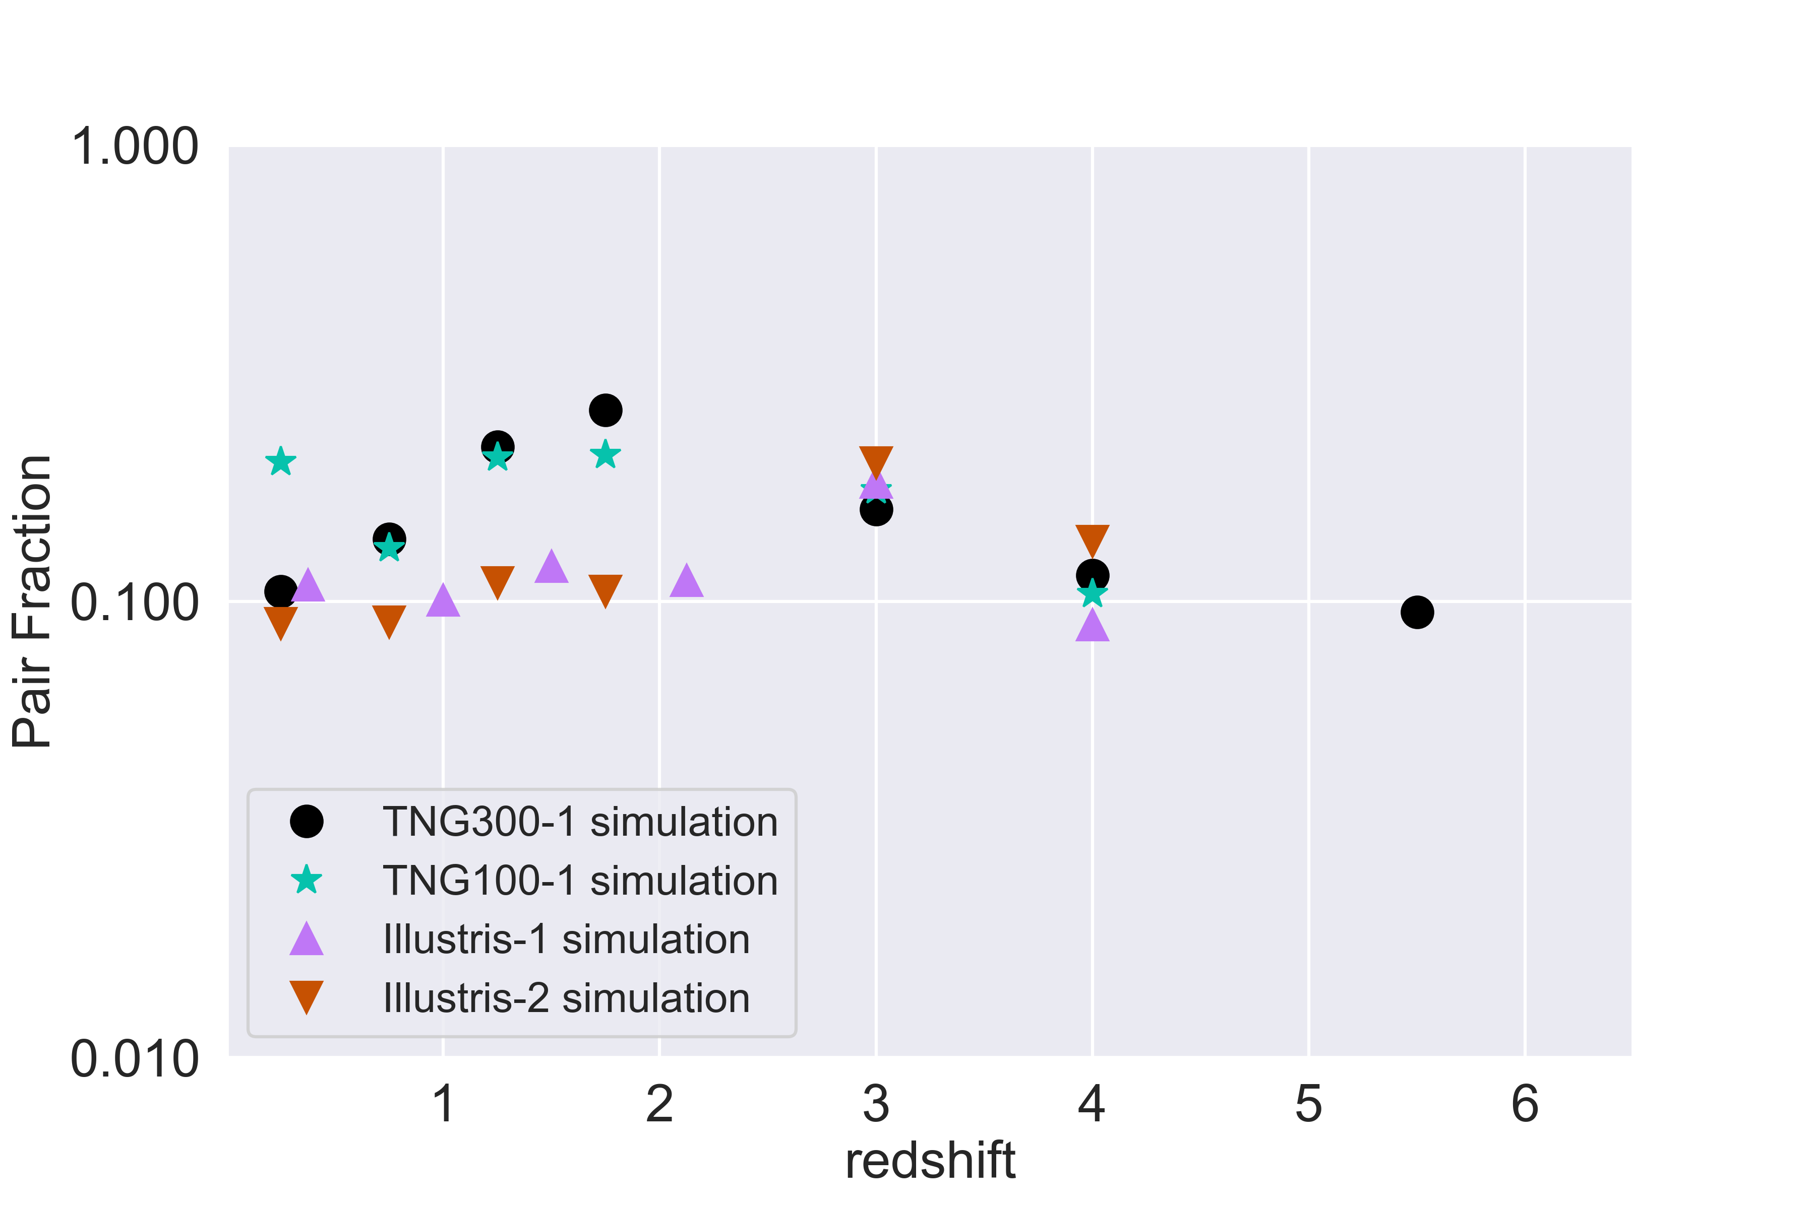
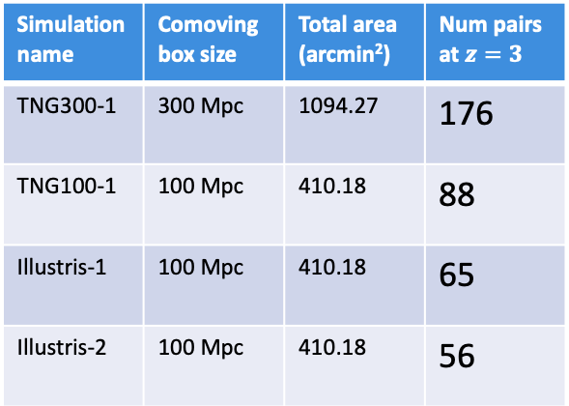
Comparing our results to previous simulations
Simulation name | Comoving box size | Total area (arcmin²) | Num pairs at $z=3$
TNG300-1 | 300 Mpc | 1094.27 | 176
TNG100-1 | 100 Mpc | 410.18 | 88
Illustris-1 | 100 Mpc | 410.18 | 65
Illustris-2 | 100 Mpc | 410.18 | 56
Notes:
Table on the side: columns: box size, total area of lightcone (sum over the three different projections), pairs counted at z=3.

Slide 13
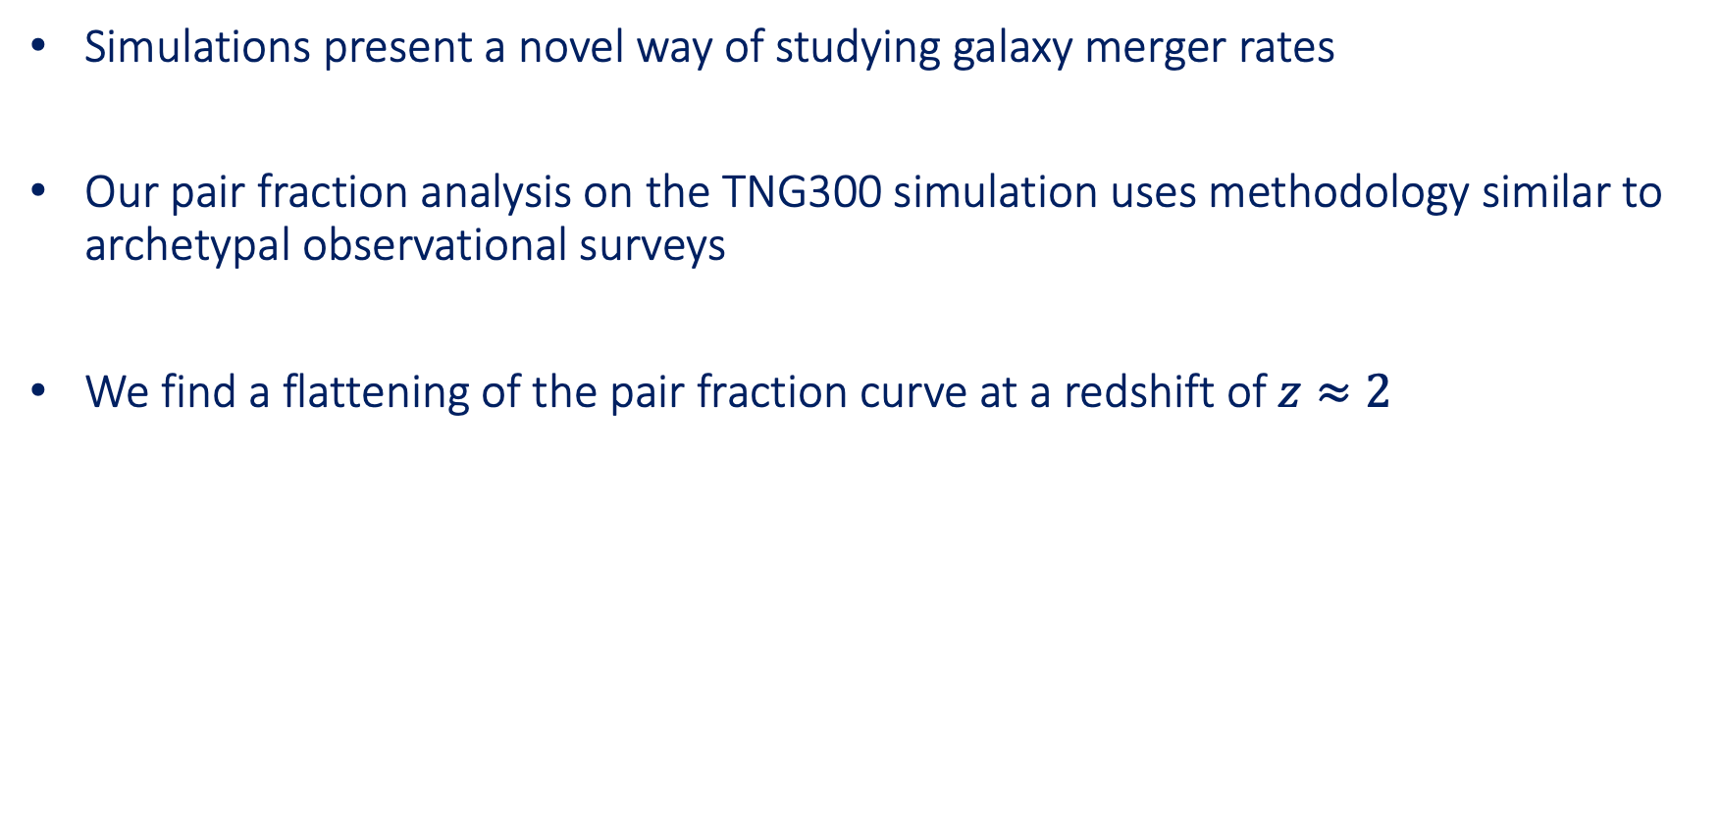
Summary
Simulations present a novel way of studying galaxy merger rates
Our pair fraction analysis on the TNG300 simulation uses methodology similar to archetypal observational surveys
We find a flattening of the pair fraction curve at a redshift of $z≈2$

Slide 14
Special thanks to my mentor Greg Snyder, program coordinators Carolyn Slivinski and
Ivelina Momcheva, and the fantastic IT services division.
To everyone else here at space telescope, thank you so much for having me!

Slide 15
Backup Slides

Slide 16
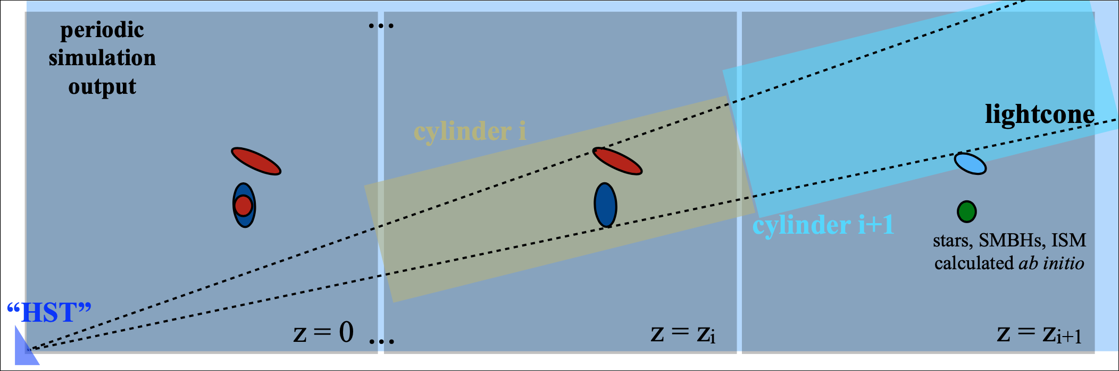
So you want to build a lightcone…
Snyder et al. 2017/Overzier et al. 2013

